Slide 1

Wireless Network
MIT-
By-
Jesmin Akhter
Associate Professor
Institute of Information Technology
Jahangirnagar University

Slide 2

Lecture 06 GSM

Slide 3
The characteristics of the initial GSM Standard
Fully digital system utilizing the 900 MHz frequency band
8 full rate or 16 half rate TDMA channels per carrier
Low power handsets – support sleep mode
Subscriber Identity Modules (SIM cards)
User terminal authentication fraud control
Security with encryption of speech and data transmissions over the radio path
Fully international roaming
Low speed data service (up to 9.6 Kbps)
Compatibility with ISDN
Support short message service (SMS)
Additional features : call waiting, voice mail, group calling,
caller id etc.
Notes:
One GSM radio channel consists of eight time slots per radio frame, meaning that in this case, up to eight users can share one channel simultaneously. It is actually possible to squeeze in up to 16 users into one GSM channel through utilizing what is called half-rate coding, at the expense of fewer bits being available per user and hence potentially a somewhat degraded voice quality

Slide 4
Air Interface: Physical Channel
Two frequency bands 45 MHz apart have been reserved for GSM operation:
890 -915 MHz for Up link (transmission from MS to BTS)
935 - 960 MHz for Down link(transmission from BTS to MS)
On the physical layer GSM uses a combination of FDMA and TDMA for multiple access.
Combination of frequency division and time division multiplexing
FDMA
124 channels of 200 kHz
200 kHz guard band
TDMA
Burst
The transmission of the data during the single time slot is known as a burst.
Notes:
On the physical layer GSM uses a combination of FDMA and TDMA for multiple access. Two frequency bands 45 Mhz apart have been reserved for GSM operation: 890-915 MHz for transmission from MS to BTS (Uplink) and 935-960 MHz for transmission from BTS to MS (Down link).
Each of these bands of 25 MHz width is divided into 124 single carrier channels of 200 kHz width. In each of the up-link / down-link bands there is a guard-band of 200 kHz. This variant of FDMA is also called Multi-Carrier(MC). Each Radio Frequency Channel (RFCH) is uniquely numbered, and a pair of channels with the same number forms a duplex channel with a duplex distance of 45 MHz.
The modulation used for coding is GSMK.
In US, certain operators implement GSM standard on a frequency band around 1900 MHz (GSM-1900)
1850-1910 MHz for Up link
1930-1990 MHz for Down link
TDMA mainly transmit data in a buffer-and-burst method and the transmission of any user is non- continuous.

Slide 5
In US, certain operators implement GSM standard on a frequency band around 1900 MHz (GSM-1900)
1850-1910 MHz for Up link
1930-1990 MHz for Down link
Transmission rate: 270kbps
Speech coded at 13kbps
Cell pattern: 3/9, 4/12
Modulation used
Gaussian Minimum Shift Keying (GMSK)

Slide 6
GSM Architecture
PSTN/PLMN
PSTN
VLR
MSC
HLR
AUC
A
EIR
BSS
BSC
BTS
BTS
Um
MS
MS
ME+SIM
Notes:
IMEI-international mobile equipment identifier
IMSI-international mobile subscriber identity
TMSI-Temporary mobile subscriber identity

Slide 7
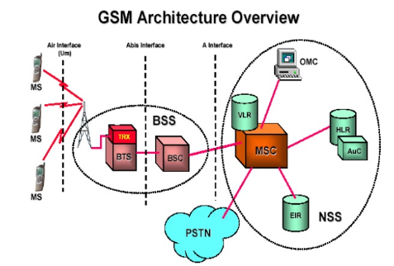
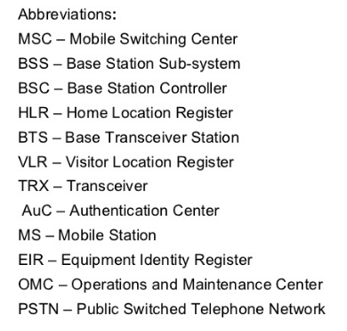
Network switching subsystem (NSS) (or GSM core network) is the component of a GSM system that carries out call out and mobility management functions for mobile phones roaming on the network of base stations.
Notes:
Network switching subsystem (NSS) (or GSM core network) is the component of a GSM system that carries out call out and mobility management functions for mobile phones roaming on the network of base stations.

Slide 8
Home Location Register (HLR) represents a centralized database that has the permanent datafill about the mobile subscribers in a large service area (generally one per GSM network operator).
The HLR is kept updated with the current locations of all its mobile subscriber, including those who may have roamed to another network operator within or out side the country. The routing information is obtained from the serving VLR on a call by call basis.

Slide 9
The Visiting Location register (VLR) represents a temporary data store and there is one VLR per MSC. This register contains information about the mobile subscriber who are currently in the service area covered by the MSC/VLR. VLR includes:
Features currently activated
MS identity
Current location

Slide 10
Authentication Center (AUC): Generally associated with the HLR, the authentication center contains authentication parameters that are used on initial location registration, subsequent location updates and on each call set-up request from the MS.
In GSM , protection from unauthorized access is achieved through strong authentication procedures that validate the true identity of subscriber before he or she is permitted to receive service.
The authentication and ciphering functions in GSM are closely linked and are performed as a single procedure between MS and the network.

Slide 11
An authentication algorithm A3, a cipher key generation algorithm A8 and an encryption algorithm A5, individual subscriber authentication key (Ki) are also programmed into the MS at the time of service provisioning. The relevant call flows are shown in fig.1
5
4
3
5
4
3
BSC
MSC
3 4 5
4 3
VLR
MS
1 2
SIM with A3, A5, A8, Ki
HLR

Slide 12
VLR sends IMSI (International Mobile Subscriber Identity) to the HLR.
HLR returns security triplets (RAND, SRES, Kc) to the VLR
For authentication and ciphering the VLR sends RAND to the MS.
Using stored A3 algorithm and secret key Ki stored in the SIM, and RAND provided by the VLR the MS calculates SRES (Signed Response) and returns it to the VLR. Using the A8 algorithm and Ki, The MS also calculates the cipher key Kc.
If the SRES returned by the MS matches with the stored SRES in the VLR, the VLR sends the cipher key Kc to the BTS which uses Kc for ciphering the radio path (down link)
MS uses its Kc to cipher the radio path (uplink) using encryption algorithm)
5
4
3
5
4
3
BSC
MSC
4 3
3 4 5
VLR
MS
1 2
SIM with A3, A5, A8, Ki
HLR

Slide 13
RAND is randomly generated 128 bit number used
for providing triples always different.
• SRES (signed response) is 32 bit long number
generated by A3 algorithm and used as digital
signature of MS.
• Kc is 64 bit ciphering key generated by A8
algorithm and used for encrypting data between MS
and SGSN.

Slide 14
Equipment Identity Register (EIR): The EIR maintains information to authenticate terminal equipment so that fraudulent, stolen on non-type-approved terminals can be identified and denied service.

Slide 15
Thank You

